Slide 1
Making this resource work for you
Prior to teaching this lesson, please refer to the ‘Unit Overview and Planning Document’.
Further guidance on planning Science Mastery lessons can be found in the detailed planning guidance document.
Refer to the ‘notes’ section on each slide for useful information, including suggested expositions, pedagogical content knowledge, suggested questions, answers and more. Consider using presenter mode so you can see this guidance throughout the lesson.
The introduction slides can be adapted to suit your teaching style and the needs of your class.
Before the lesson, adapt the fix-it slide to address any misconceptions identified in the previous lesson’s exit ticket.
Choose from the suggested activities to suit your class. The intention is not that you complete all of these, but that you select those which ones are most appropriate for your students. It may be appropriate to further adapt activities for your students.
These lessons are designed to occupy approximately 1 hour. To adapt for a shorter or longer lesson duration we advise you to adapt the activity section accordingly.
Please consider using the final slide to send feedback about this lesson or examples of PowerPoints that you have adapted to our design team. Your feedback is used to improve Science Mastery for all of our teachers and students. We appreciate all suggestions and comments.
Thank you for reading!
The Science Mastery Team

Slide 2

Prior Knowledge Review: Reactions of Metals
Answer the questions below.
Define ‘the reactivity series’.
Where does gold appear on the reactivity series?
Define ‘oxidation’.
Define ‘reduction’.
What name is given to minerals that contain enough metal to be extracted economically?
The reactivity series is a list of metals arranged in order of reactivity (from most reactive at the top to least reactive at the bottom)
Gold appears at the bottom of the reactivity series.
Oxidation is the addition of oxygen.
Reduction is the loss of oxygen.
Ore
Notes:
Big idea: Reactions Rearrange Matter
Foundation: What non-metal can be used to extract metals less reactive than itself?
Stretch: Why is carbon considered a ‘reducing agent’?
Answers:
Foundation: Carbon
Stretch: Carbon is considered a reducing agent because it reduces other substances.

Slide 3
Prior Knowledge Review: Reactions of Metals
Do Now:
Define ‘the reactivity series’.
Where does gold appear on the reactivity series?
Define ‘oxidation’.
Define ‘reduction’.
What name is given to minerals that contain enough metal to be extracted economically?
Drill:
Put potassium, copper and carbon in order of reactivity.
Why does copper oxide react with carbon?
Name the two products of this reaction.
Notes:
Answers:
Do Now:
1. The reactivity series is a list of metals arranged in order of reactivity (from most reactive at the top to least reactive at the bottom)
2. Gold appears at the bottom of the reactivity series.
3. Oxidation is the addition of oxygen.
4. Reduction is the loss of oxygen.
5. Ore
Drill:
Potassium, carbon, copper
Because carbon is more reactive than copper, it can displace copper from a compound, in a displacement reaction
carbon dioxide and copper

Slide 4
Prior Knowledge Review: Reactions of Metals
Read Now:
Nikolai Beketov was a Russian scientist, born in 1827. He was a chemist and metallurgist. Beketov determined the reactivity series of metals. He discovered the displacement of metals from solutions of their salts, using hydrogen. He also established that magnesium and zinc displaced other metals from their salts. In 1864, Beketov organised the department of physical chemistry at Kharkiv University, and taught the first course in physical chemistry as an independent subject.
Kharkiv University is located in the North-East of Ukraine. In March 2022, many of the University buildings were heavily damaged due to the Russian invasion into Ukraine.
Where was Nikolai Beketov from?
What subjects did Beketov study?
What did Beketov discover?
In which University did Beketov work?
Which topic did Beketov teach as an independent subject for the first time?
Notes:
Answers:
Russia
Chemistry and Metallurgy (the study of metals and alloys)
Beketov discovered that magnesium and zinc displace metals from their salts
Beketov worked in the Kharkiv University
Beketov taught physical chemistry as an independent subject for the first time

Slide 5

C4.2.1
02/10/2023
Prior Knowledge Review:
Reactions of Metals
C4.2.1 PKR: Reactions of Metals
C4.2.2 Extracting Less Reactive Metals
C4.2.3 PKR: Ions, Ionic Bonding and Deducing Ionic Formulae
C4.2.4 (HT) Ionic Equations and Displacement Reactions
C4.2.5 (HT) Writing Half Equations
C4.2.6 (HT) Ionic Equations for the Reactions of Acids and Metals
C4.2.7 Introduction to Electrolysis
C4.2.8 Extracting Metals by Electrolysis
C4.2.9 Electrolysis of Molten Ionic Compounds
C4.2.10 Electrolysis in Solutions
C4.2.11RP: Electrolysis of Aqueous Solutions 1
C4.1.12 RP: Electrolysis of Aqueous Solutions 2
C4.1.13 TIF: Corrosion and its Prevention
C4.2.14 (HT) Obtaining Raw Materials
C4.2.15 Recycling Metals
C4.2.16 Feedback Lesson
Notes:
Big Idea: Reactions Rearrange Matter
Suggested Hook:
Give students 1 minute to write down or draw anything they can recall about the reactivity series.

Slide 6

Following this lesson, students will be able to:
List metals in order of reactivity
Describe the reactions of acids and metals
Predict the salts formed in neutralisation reactions
Key Words:
reactivity
neutralisation
salt
Notes:
Guidance:
See unit overview document and planning guidance to see how these objectives are typically assessed at GCSE, including examples of what students should be able to do following this lesson.
Planning for different needs:
The learning objectives given on this slide are suggested based on the most common requirements for exams, however they can be adapted based on the needs of different classes.
For best practice, the unit preparation booklet should be used to determine the appropriate focus of lessons within the unit.
While it is not possible to explicitly split content into levelled grades, we recommend that lesson objectives can be classified as critical, core or stretch.
Critical: the content or skill is essential for all students to be able to progress.
Core: the content or skill is important for students to progress, but other opportunities may be available to revisit it.
Stretch: the content or skill may not be essential for all students but is important for students aiming for the highest grades.
Key skill: this is a crucial skill being developed in this unit as part of the skill mapping
C4.2.1 Lesson Objectives:
Critical: List metals in order of reactivity
Critical: Describe the reactions of acids and metals
Critical: Predict the salts formed in neutralisation reactions

Slide 7
Reactions of metals
most reactive
Potassium
Sodium
Some metals are more reactive than others.
The reactivity series is a list of metals from most reactive to least reactive.
Calcium
Magnesium
Aluminium
Carbon
Zinc
Which is the most reactive metal in each pair?
Iron
✓
Tin
Lead
Aluminium
Magnesium
Zinc
✓
Lead
Hydrogen
✓
Copper
Gold
Silver
Sodium
Calcium
✓
Silver
Gold
least reactive
Platinum
Notes:
Model teacher exposition:
We’ve looked at iron and we’ve seen that when there is water present it will react with oxygen in the air, to form rust.
There are lots of different metals. Remind me, where would we find these metals on the Periodic table? On the left and in the middle.
Some metals are extremely reactive and they react vigorously when they come into contact with air, or water. What is an example of such a metal? Potassium – from (prior learning from C3.1, The Periodic Table unit).
How do we know from observing the reaction of potassium with water that it is a reactive metal? Linking back to C3.1 again – it moved quickly across the surface of the water due to the rapid production of hydrogen gas, it burned with a lilac flame due to the high temperature of the reaction setting the hydrogen gas alight, there was rapid fizzing.
Other metals are unreactive. It doesn’t matter how long they are in contact with air, or water, or another substance. They will not react. What is an example of such a metal? Platinum, gold, or other unreactive metal.
Scientists often place metals in a list called the reactivity series. This is simply a list of metals in order from the most reactive at the top, to the least reactive at the bottom.
As we have discussed, potassium is an extremely reactive metal, so it sits at the very top. Platinum and gold and extremely unreactive, so they sit at the bottom. This is one of the reasons we make jewellery from metals like gold. What would happen if we were to make jewellery from an unreactive metal?
Teacher guidance:
You may want to draw students attention to the fact that we include carbon and hydrogen (two non-metals) in the reactivity series. It’s not important to explain why at this point, however the inclusion of carbon will be explained next lesson.

Slide 8
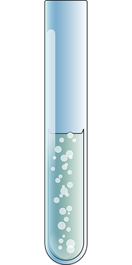
How can we use observations to place metals in order of reactivity?
When a metal reacts with an acid, a salt and hydrogen are made.
metal + acid → salt + hydrogen
How do we know that a chemical reaction is occurring?
Bubbles observed in the solution show that a gas is being made in the chemical reaction.
Notes:
Exposition type: Demonstration
Students will have met the reaction between an acid and a metal before. There is an opportunity here to recap this in more detail by reminding students of how to name a salt using different acids, and giving them word equations to complete. This could be by filling in the blanks in word equations, and increasing the challenge to students constructing their own word equations given the reactants or products.
Model teacher exposition:
When a metal reacts with an acid, a salt and hydrogen are made.
We can write a general word equation to show this reaction, remembering that the reactants go on the left of the equation, and the products on the right: point to each part of the equation, reminding students of the link between which substances are reactants and products, and how we show that in equation form.
Take a test tube, acid, and some magnesium ribbon. Use a visualiser if available so that students can see what happens clearly on the screen (without getting up and crowding around). Carefully add the ribbon to the acid and give students a minute to observe carefully.
How do we know a chemical reaction is occurring here? We can see bubbles evolving.
What does this indicate to us? A gas is being produced.
A gas is a new product – a new substance is being produced here, so this is definitely a chemical reaction.
What do you think this gas is? Hydrogen gas.
Od course – because our equation here tells us that when we add a metal to an acid, we will be making a salt and hydrogen gas. At this point you could carry out the test for hydrogen to prove that it is in fact hydrogen gas being produced. Place your thumb over the mouth of the test tube and wait until you can feel the slight pressure of the gas building up Then, bring a lit splint to the mouth of the test tube. A squeaky pop indicates that hydrogen is present. This is not required knowledge for this lesson, but useful for students to see.
What other product is being produced here? A salt
We can see from our equation here that a salt and hydrogen has are produced. But, I can’t see a salt – my liquid still looks like it did in the beginning. Where is my salt? Is is dissolved in the liquid.
So the salt is produced but dissolved in this liquid, so I can’t see it. You have come across this reaction before, where you learned to name the salt produced by different acids and metals. Give students a couple of examples of acids and metals and ask them to word out the name of the salt as a quick recap, for example hydrochloric acid + calcium will make the salt calcium chloride.
Bonus question! If I wanted to separate that salt from the liquid, what separation technique would I use? Distillation.
Image from pixabay

Slide 9
Using the Reactivity Series
Potassium
Sodium
The reactivity series can be used to make predictions about the reactions of metals.
Use the reactivity series to predict whether a reaction will take place and how intense the reaction will be.
Calcium
Magnesium
Aluminium
Carbon
Zinc
Iron
Metal | Reacting with | Prediction
Silver | Acid
Sodium | Water
Gold | Oxygen
Potassium | Oxygen
Tin
no reaction
Lead
reacts vigorously
Hydrogen
no reaction
Copper
reacts vigorously
Silver
Gold
Platinum

Slide 10
How many ways can neutralisation happen?
Did you know?
Calcium carbonate can be found in rocks as a mineral.
Alkalis/Bases
They react with acids to produce salt and water.
These can be metal oxides or metal hydroxides.
Metal Carbonates
A metal carbonate is a compound containing a metal, carbon and oxygen. They react with acids to produce a salt, water and carbon dioxide.
Acid + Alkali → Salt + Water
Acid + Base → Salt + Water
Acid + Metal Carbonate → Salt + Water + Carbon Dioxide
Notes:
Exposition type: explanation
Suggested exposition:
Neutralisation can happen in a few ways, in this lesson we will look at two ways this can happen. We are already familiar with the first reaction where acids react with alkalis to make salt and water. Notice that there is the word base next to alkali, alkali is a type of base that are soluble while most bases are solid. In the making salt practical, we used a base (magnesium oxide).
The general equations for the reactions of alkalis and bases with water are similar:
Acid + alkali → salt + water
Acid + base → salt + water
The other way neutralisation can happen is by reacting acids with metal carbonates. Metal carbonates are compounds that contain metal, carbon and oxygen (remember the meaning of the suffix -ate). Metal carbonates react with acids to produce salt and water, plus another product, carbon dioxide. Because of this, if we do this reaction in the lab, we will notice that there are bubbles forming or fizzing (can use example of opening a can of coke where CO₂ fizzes out. When we made a salt using an acid and a base, no bubbles were formed because there was not a gas produced as a product.
The general equation for the reaction between metal carbonates is: Acid + metal carbonate → salt + water + carbon dioxide
Note: At this point, the word base has not been explicit taught. Alkalis are bases that dissolve in water (soluble). Bases do not dissolve in water (insoluble)

Slide 11
How many different ways can neutralisation happen?
A base is a substance that can react with acids and neutralise them. Most are insoluble.
Examples of bases: copper oxide (CuO), zinc oxide (ZnO)
Examples of alkalis: sodium hydroxide (NaOH), potassium hydroxide (KOH)
Examples of carbonates: copper carbonate (CuCO₃), calcium carbonate (CaCO₃)
Alkalis are soluble bases.
Carbonates are bases, they are insoluble and neutralise acids to make salt, water and carbon dioxide.
Notes:
Exposition type: explanation
Suggested exposition:
We will now review each of theses substances and look at examples for each.
Bases:
A base is a substance that can react with acids and neutralise them and most bases are insoluble.
What does insoluble mean?
Cannot dissolve in water.
Examples of bases are many metal oxides, such as copper oxide and zinc oxide.
Alkalis:
Alkalis are soluble bases. This means they can also react with acids and neutralise them but the difference is that alkalis are soluble.
What does soluble mean?
Can dissolve in water. This means that most alkalis are aqueous solutions.
Examples of alkalis are many hydroxides, including sodium hydroxide and potassium hydroxide.
Was the magnesium oxide we used to make a salt a base or an alkali?
It is a base since it is insoluble.
How do we know that it is insoluble?
Because it can be filtered out from the solution.
Carbonates:
Carbonates are also bases and are also insoluble. They can neutralise acids to form a salt, water and carbon dioxide.
Carbonates are also bases, the difference is that when carbonates reacts with acid, carbon dioxides are also produces along with salts and water.
Examples of carbonates are copper carbonate and calcium carbonate.
Note: Through this unit thus far, we have only been using the word alkali and have only briefly use base on making salts practical due to the use of magnesium oxide. Here is where students will be consolidating their knowledge on bases. They should be able to differentiate between alkali and bases.
It is important here to stress there difference between alkali and bases, students should know a few examples for each. Students would also be getting familiar with examples of carbonate.

Slide 12
Neutralisation reactions
Acid + Alkali/Base → Salt + Water
Acronym: A + A/B → S + W
Acids + metal carbonates → salt + water + carbon dioxide
Acronym: A + C → S + W + C
How might your observations be different for the two reactions above?
When acid reacts with metal carbonates, carbon dioxide is released.
There will be bubbles/fizzing formed. This will not happen when an acid reacts with an alkali or base.
Notes:
Suggested script:
As a summary, when acid reacts with alkali/base, salt and water are the only product. With metal carbonate, acids form salt, water and carbon dioxide.
How might the observations of these reactions differ?
When acids react with metal carbonate, there will be fizzing due to the carbon dioxide produced, which will not happen when an acid reacts with an alkali or base.
Note:
A good mnemonic for this reaction is AASW (Ants Always Swim in Water) and ACSWC (Ants Can’t Swim With Clothes)
Students will not have learned about the test for carbon dioxide by this point - this will be introduced with testing for gases in C2.2.

Slide 13
Copy and complete the equations below
Salt + water
Acids + alkali/base →
Acids + metal carbonates →
Hydrochloric acid + lithium oxide →
Nitric acid + magnesium hydroxide →
Sulfuric acid + copper carbonate →
Hydrochloric acid + calcium carbonate →
Salt + water + carbon dioxide
Lithium chloride + water
Magnesium nitrate + water
Copper sulfate + water + carbon dioxide
Calcium chloride + water
+ carbon dioxide

Slide 14




Which statements do you agree with?
Houria: Carbonate salts are formed when acid reacts with metal carbonates
Jo: Alkali is not a base
Sam: Reaction between acid and metal carbonates forms bubbles due to oxygen being released
Maysa: Neutralisation reaction does not always form neutral salts
Notes:
What to do?
Turn and talk – circulate the class and determine the common misconceptions. Listening in to the conversations of each group will often give you insights into how your students are thinking. MWB- students to write correct answers on MWB before the discussion, increasing accountability of each student and a good way to guarantee engagement.
Discuss, draw out error and think of correction for each statement.
Expected Answers:
Jo (wrong): Alkalis and metal carbonates are bases. This is because bases are substances that can react with acid to neutralise them. Both alkali and metal carbonates have that ability.
Sam (wrong): The reaction between acid and metal carbonates forms salt, water and carbon dioxide. The bubbles formed are due to carbon dioxide being produced not oxygen.
Houria (Wrong): Carbonates salts are used in a neutralisation reaction with acid but the salts of the acid is formed. For example, the salt formed by the reaction of Calcium Carbonate and hydrochloric acid is Calcium Chloride. Therefore, rathe than carbonate salts being formed, chloride salts were formed.
Maysa (correct): This is a common misconception that has been addressed in previous lesson but revisit here. Neutralisation does not always form neutral salts. Some salts are alkaline/acidic. Pupils do not need to know the detail of this until much later but it is useful for them to know at this stage that salts are not always neutral.
Suggested guidance:
Talk tasks can be used in a variety of ways to suit the particular needs of the students you are teaching. Through exchanging views with others, students develop their understanding of the science beyond what could be achieved individually.
Science classrooms that successfully integrate talk have the following features:
Science talk is a regular feature of lessons and is woven into classroom activities.
Students are paired or grouped strategically by the teacher to ensure productive interaction. This might take into consideration the students’ proficiency of the English language, how encouraging they might be to peers and their attainment in the topic. It’s a good idea to consider these pairings in the class seating plan.
Students are encouraged and supported to talk, but are not forced to talk.
The teacher should take on the role of a facilitator, engaging with conversations where necessary and encouraging or steering the conversation where needed.
Students are encouraged to use the language they have to express their ideas (e.g., everyday language, imperfect English, native language), but also to incorporate science specific terminology where this is more accurate or has been taught.
6. Scientifically inaccurate ideas are not dismissed by the partner or teacher; open discussion and further investigation are relied on to help students construct ideas that support them to progress in their scientific understanding.
7. Guidelines for behaviour during talk tasks are explicit and frequently reviewed. Rules for students might be:
Listen carefully to your partner
Take turns talking.
Speak one at a time, without interrupting.
Politely agree or disagree and explain why.
Politely point out if your partner has used a scientific word incorrectly, if they have explained the science incorrectly, or if there is a more accurate way to describe something.
If confused, ask questions.
Stay focused on the discussion topic.
Respond to one another.

Slide 15
Place these metals in order of reactivity
Gold
Sodium
Silver
Potassium
Aluminium
Iron
Lithium
Notes:
Suggested guidance:
Talk tasks can be used in a variety of ways to suit the particular needs of the students you are teaching. Through exchanging views with others, students develop their understanding of the science beyond what could be achieved individually.
Science classrooms that successfully integrate talk have the following features:
Science talk is a regular feature of lessons and is woven into classroom activities.
Students are paired or grouped strategically by the teacher to ensure productive interaction. This might take into consideration the students’ proficiency of the English language, how encouraging they might be to peers and their attainment in the topic. It’s a good idea to consider these pairings in the class seating plan.
Students are encouraged and supported to talk, but are not forced to talk.
The teacher should take on the role of a facilitator, engaging with conversations where necessary and encouraging or steering the conversation where needed.
Students are encouraged to use the language they have to express their ideas (e.g., everyday language, imperfect English, native language), but also to incorporate science specific terminology where this is more accurate or has been taught.
6. Scientifically inaccurate ideas are not dismissed by the partner or teacher; open discussion and further investigation are relied on to help students construct ideas that support them to progress in their scientific understanding.
7. Guidelines for behaviour during talk tasks are explicit and frequently reviewed. Rules for students might be:
Listen carefully to your partner
Take turns talking.
Speak one at a time, without interrupting.
Politely agree or disagree and explain why.
Politely point out if your partner has used a scientific word incorrectly, if they have explained the science incorrectly, or if there is a more accurate way to describe something.
If confused, ask questions.
Stay focused on the discussion topic.
Respond to one another.

Slide 16
Hold up 1, 2 or 3 fingers to answer
Which of the following is a characteristic of chemical reactions?
1. The change is irreversible
2. The change is reversible
3. A new product is not made
Which of the following gases is made in the reaction between a metal and an acid?
Carbon dioxide
Oxygen
Hydrogen
Which symbol is used to separate the reactants and products in a word or symbol equation?
=
+
→
✓
✓
✓
Notes:
Purpose: to check that key knowledge from the introduce phase has been learnt and understood.

Slide 17
Drill
What is the reactivity series?
Where are the most reactive metals in the reactivity series?
Where are the least reactive metals in the reactivity series?
What is produced when an acid reacts with a metal?
What is produced when an acid reacts with a metal carbonate?
Give an example of a base.
What will be observed with an acid reacts with a metal carbonate
What is the chemical formula for hydrochloric acid?
What is the chemical formula for sulphuric acid?
Write a word equation for the reaction between nitric acid and magnesium.
Notes:
Purpose: This is a knowledge drill. The purpose of this is to check that the critical knowledge is secure before pupils move onto independent practice.
Suggested guidance: There are a range of ways this could be done depending on time and ability range of the class:
Mini whiteboards
As full sentences in exercise books
As short answers in exercise books
In the pupil workbook
As pair talk
As cold call

Slide 18
Drill answers
The reactivity series is a list of metals in order of reactivity.
The most reactive metals are at the top of the reactivity series.
The least reactive metals are at the bottom of the reactivity series.
a salt and water
salt, water and carbon dioxide
Copper oxide, zinc oxide
Bubbles of carbon dioxide will be observed
HCl
H₂SO₄
Magnesium + nitric acid → magnesium nitrate + hydrogen
Notes:
Purpose: This is a knowledge drill. The purpose of this is to check that the critical knowledge is secure before pupils move onto independent practice.
Suggested guidance: There are a range of ways this could be done depending on time and ability range of the class:
Mini whiteboards
As full sentences in exercise books
As short answers in exercise books
In the pupil workbook
As pair talk
As cold call

Slide 19
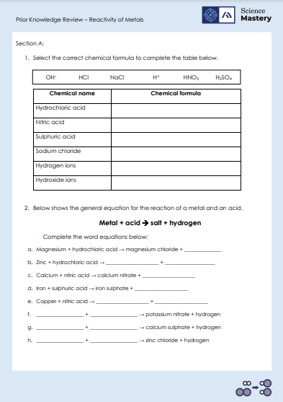
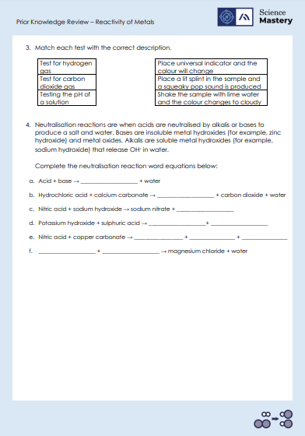
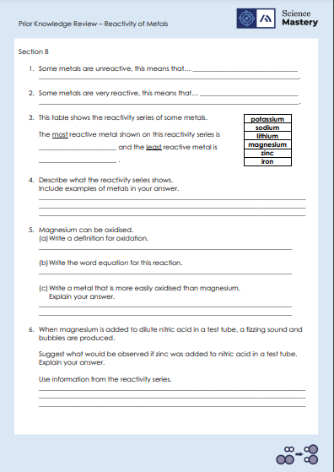
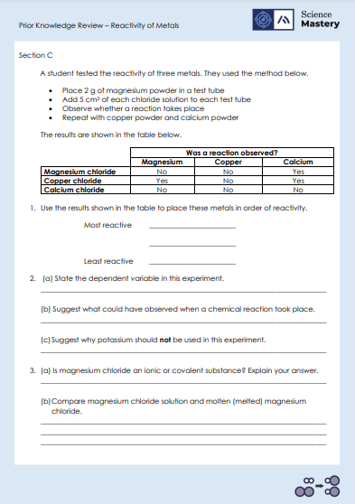
Activity

Slide 20
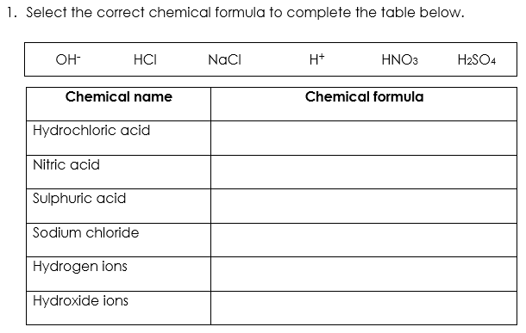
Answers – Section A
HCl
HNO₃
H₂SO₄
NaCl
H⁺
OH⁻

Slide 21
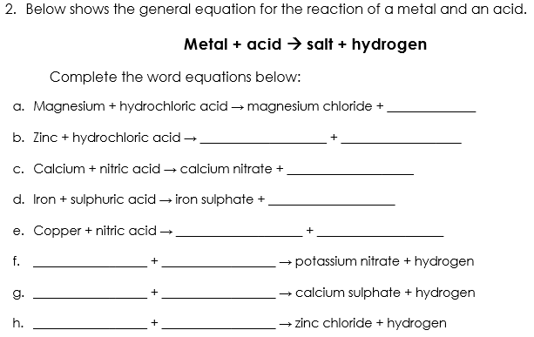
Answers – Section A
hydrogen
zinc chloride
hydrogen
hydrogen
hydrogen
copper nitrate
hydrogen
Potassium
nitric acid
Calcium
sulphuric acid
Zinc
hydrochloric acid

Slide 22
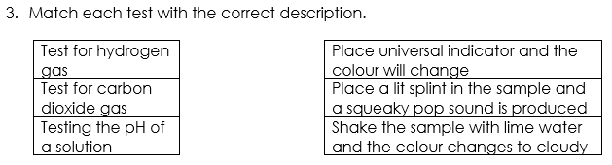
Answers – Section A

Slide 23
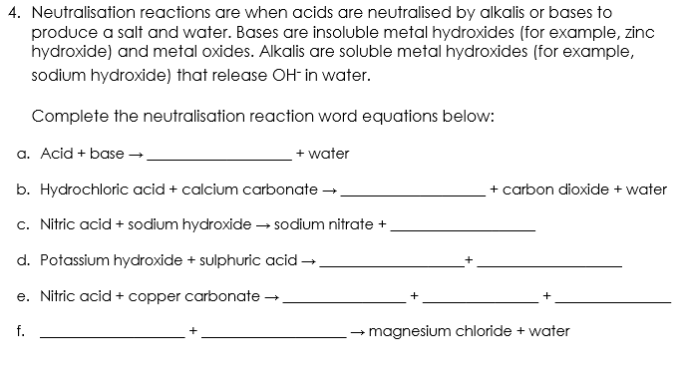
Answers – Section A
salt
calcium chloride
water
potassium sulphate +
water
copper nitrate
water
carbon dioxide
Magnesium hydroxide
hydrochloric acid

Slide 24
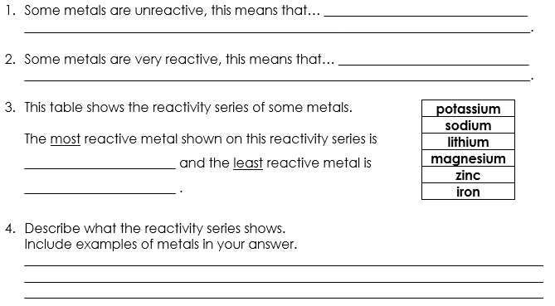
Answers – Section B
they do not easily take part in chemical reactions.
they readily take part in chemical reactions.
potassium
iron
The reactivity series is a list of metals organised from most reactive at the top and least reactive at the bottom. For example, zinc is higher than iron in the reactivity series because it is more reactive.

Slide 25
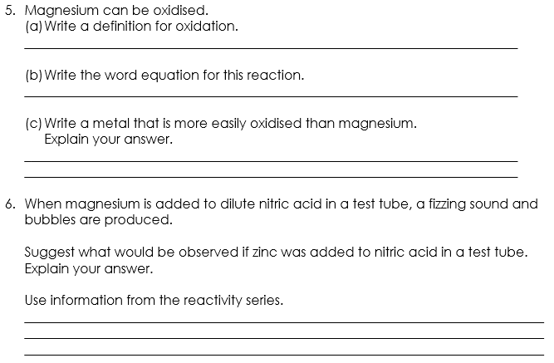
Answers – Section B
When a substance reacts with oxygen to form an oxide.
Magnesium + oxygen → magnesium oxide
Potassium/sodium/lithium is more easily oxidised than magnesium because it is more reactive.
There would be less of a fizzing sound and less bubbles produced because zinc is less reactive than magnesium. On the reactivity series, zinc is lower down than magnesium, showing that zinc is less reactive.

Slide 26
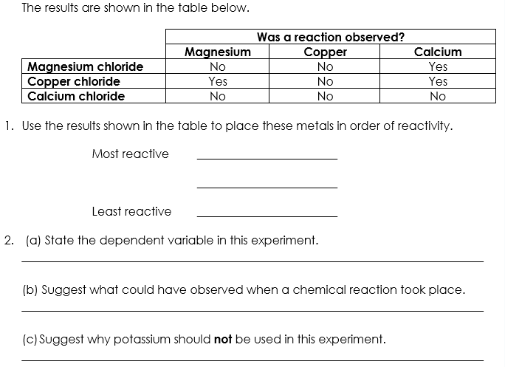
Answers – Section C
Calcium
Magnesium
Copper
Whether there was a reaction or not.
Fizzing, colour change, temperature change
Very reactive so would be dangerous to use.

Slide 27
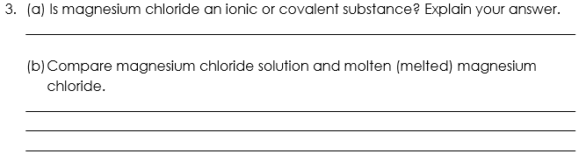
Answers – Section C
Ionic, because it is a compound formed from a metal (magnesium) and a non-metal (chlorine).
Both magnesium chloride solution and molten magnesium chloride are liquid.
Magnesium chloride solution is the compound dissolved in water whereas molten magnesium chloride is pure.

Slide 28
Answer the questions below.
What do all acids have in common?
A. They are all corrosive
B. They all have a pH of greater than 7
C. They all release hydrogen ions (H+) into solutions
D. They all release hydroxide ions (OH-) ions into solutions
✓
2. In a reaction between a metal and an acid, what will always be produced?
A. a salt and carbon dioxide
B. a salt and water
C. a salt and hydrogen gas
D. a salt, water and carbon dioxide
✓
Notes:
Q1. Answer: C
If students answer A, they have the misconception that all acids are corrosive. To fix-it, remind students that many common substances are acidic and not corrosive, such as lemon juice. Both acids and alkalis can be corrosive and can also be weak and non-corrosive.
If students answer B, they have mixed up the pH scale. Acids have a pH or less than 7, not greater than 7. To fix-it, ask students to label a diagram of the pH scale with the pH of strong and weak acids and alkalis.
If students answer D, they have mixed up the ions found in acidic solutions with those found in alkaline solutions. To fix-it, show students the chemical formulae of common acids, and ask them to identify the element common to all of these formulae – hydrogen. Explain that this is why acids in solutions always have hydrogen ions.
Q2. Answer: C
If students answer A, C or D, they have mixed up the reactions of acids and metal carbonates, metal hydrogen carbonates and alkali metals and water. To fix-it, ask students to fill in a table that suggests the chemical equations for a variety of different reactions. A model answer can be provided for each type of reaction.

Slide 29
Answer the question below.
3. What is the reactivity series?
A. It is a list of metals ordered from most reactive at the top to least reactive at the bottom
B. It is a list of metals ordered from least reactive at the top to most reactive at the bottom
C. It is a list of metals with different reactivities (some are more reactive than others)
✓
Notes:
Q3. Answer: A
If students answer B, students have mixed up the order of reactivity – it should be most reactive at the top and least at the bottom of the reactivity series. If students answer C, they have attempted to define the reactivity series, however the answer is not specific enough. To fix-it, give students a model answer to define the reactivity series. Ask them to arrange metals into a reactivity series and to explain why they decided in a particular order.

Slide 30
Lesson C4.2.1
What was good about this lesson? | What can we do to improve this lesson?
Send us your feedback by clicking this link
or by emailing sciencemastery@arkonline.org
Thank you!

